Slide 1
Final Software Project Jake Ororke University of Arizona Global Campus CST499: Capstone for Computer Software Technology Dr. Elchouemi September 24^{th,} 2022

Slide 2


Welcome Speech
Hello,
Thank you for taking some time to watch the following PowerPoint presentation regarding the College Course Management System.

Slide 3
Introduction
During this presentation I will be providing you my perspective and information on a college course management system that I recently developed. As according to American Public University (n.d.) one of the biggest problems with online college course registrations currently is the fact that when courses fill up with student’s they become no longer available in the course scheduler and there is no way to sign up for those courses until they become available again. Thus. one aspect of this software project is to have created the ability for students to be put on a wait list for the event of when desired courses become full of students. Additionally, In this presentation I will be discussing the following details related to this software project: Summarizing the key aspects of the SRS document; Showcasing the UML design model that was created for this software project; Explaining the design of the landing, login, and enrollment pages that were created; Explaining the MySQL database and class registration that was developed; Will finish by discussing the PHP code that was written for this software project.

Slide 4
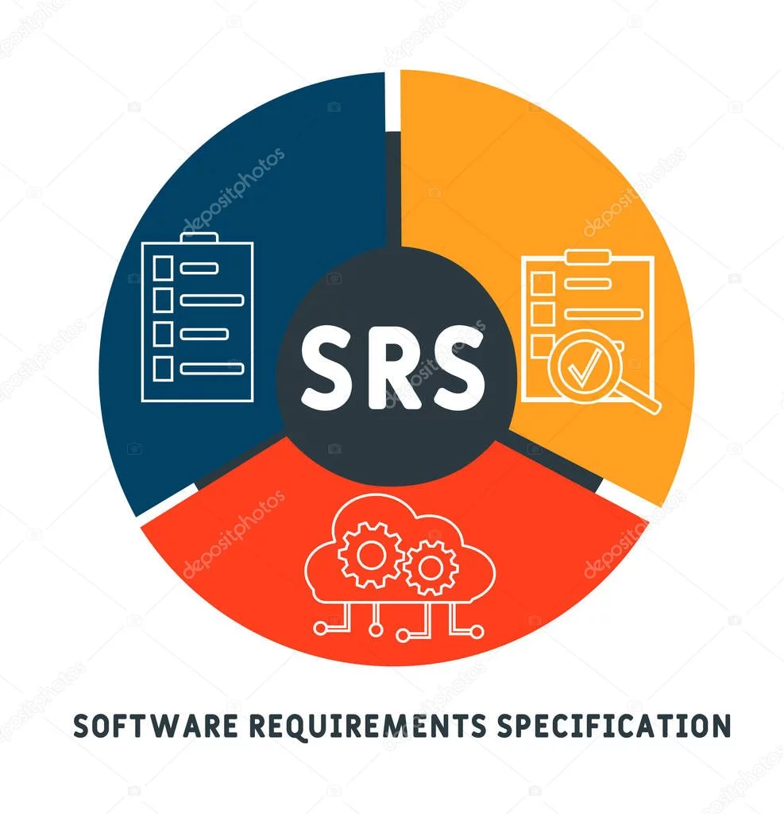
key aspects of AN SRS document
According to Tsui, et. al (2018) the following should be included in an SRS document in order to be considered in compliance with IEEE/EIA Standard 12207.1-1997:
Introduction – Describes why the SRS document exists, this includes purpose, scope, references, and terms definition
High-Level Description – Provides a general overview of the software that the SRS document is being written for
Detailed Requirements – All interfaces should be included that will interact with the software or inside the software. Details the expected functional inputs, outputs, and processes. Description of performance expectancies. Lists any design constraints.

Slide 5
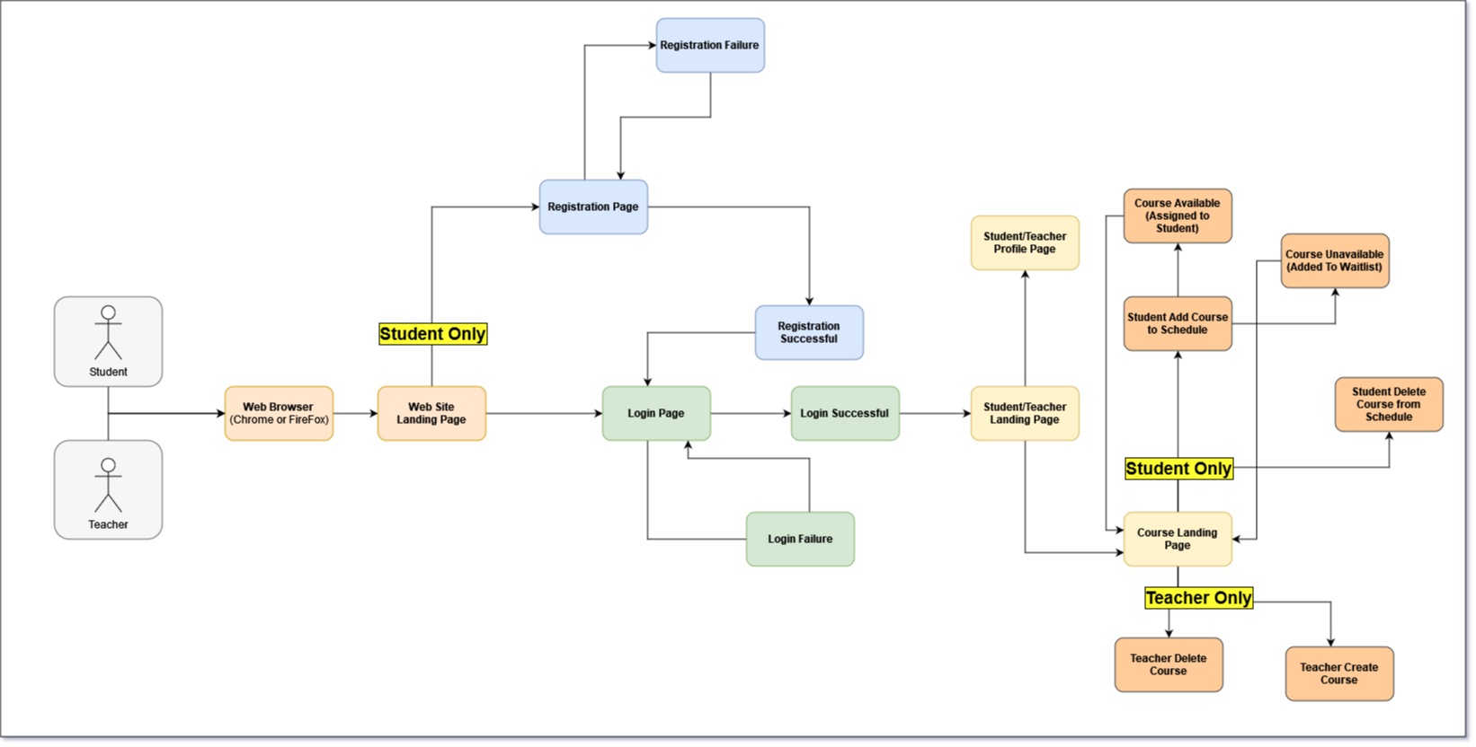
UML Design Model

Slide 6
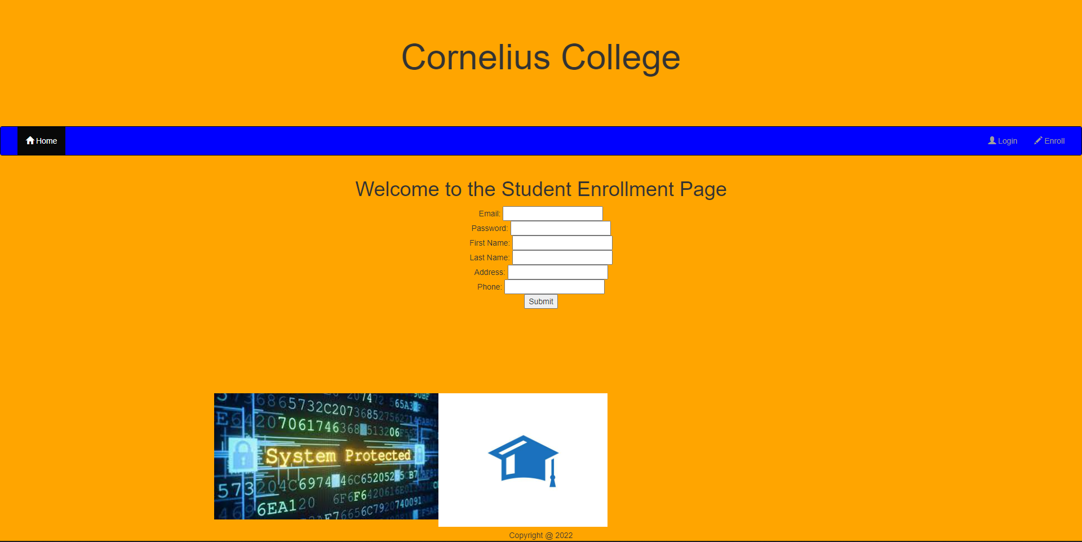
landing, login, and enrollment page Design
The design for the enrollment, login, and landing pages are kept precise, consistent, and easily readable. This should help the student keep focus on the pages and the steps to be completed on that page. Which will make it easy for the student to enroll into the system as displayed in the enrollment page to the right, we have incorporated a printout of the college name this college management system was developed for at the top of the page, the middle contains a bar for the users to change pages, if necessary, followed by the input fields for the student's personal information, then the register button at the bottom of the input fields.
Enrollment Page

Slide 7
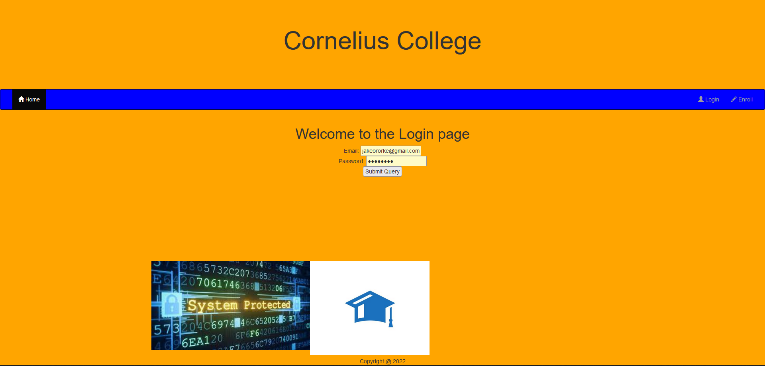
The design for the login page is similar to that of the enrollment page this is to keep the design of the pages that we have developed consistent throughout. This includes not just the background and foreground color schemes but also the input fields and the buttons on the page.
Another aspect of the design for the login page that is different than the enrollment page is the input fields here take the students or teachers email and password in order to be validated after they press on the Submit Query button. This then either informs the student or teacher that their information was correct by sending the user to the landing page or it will inform the student or teacher that their email or password was incorrect and to please try again.
Login Page

Slide 8
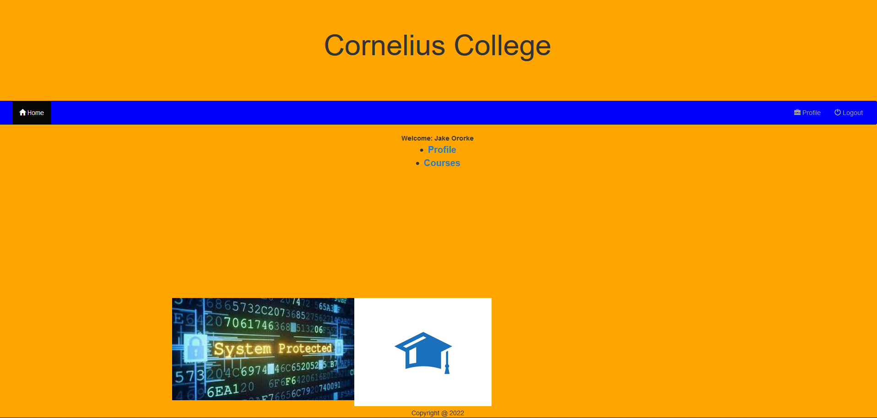
The design for the landing page while the background and foreground colors are the same as the login and the enrollment screen, this page will be automatically updated with the student or teachers name on the page as soon as they login this is completed by sending the specified session key from the login page onto the landing page.
The other aspects of the design for the user landing page is the bulletin list of links that are provided in the center of the page. This includes the Profile page link which would take the student or teacher to their individual profile pages to display their personal information, the other one being the courses landing page link which would send the user onto the courses landing page.
Landing Page

Slide 9
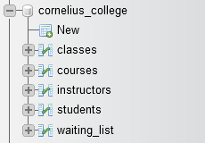
MySQL database and class registration
MySQL Database contains 5 tables, these tables include classes, courses, instructors, students, and waiting_list
Classes – Utilized as a table to control the connection between all other tables in the database, except for waiting list
Courses – Consists of all course related information
Students – Consists of all students related information
Instructors – Consists of all teacher’s information in the database
Waiting_List – consists of the courses that students are currently waiting to be available in order to be assigned that course.
Functionality for communication between the database and the course registration page as well as all other created pages is controlled through the connectDB script in which input is converted to MySQL queries and then sent to the DB, then returned and sent back to the main page.
Database and Tables Created

Slide 10
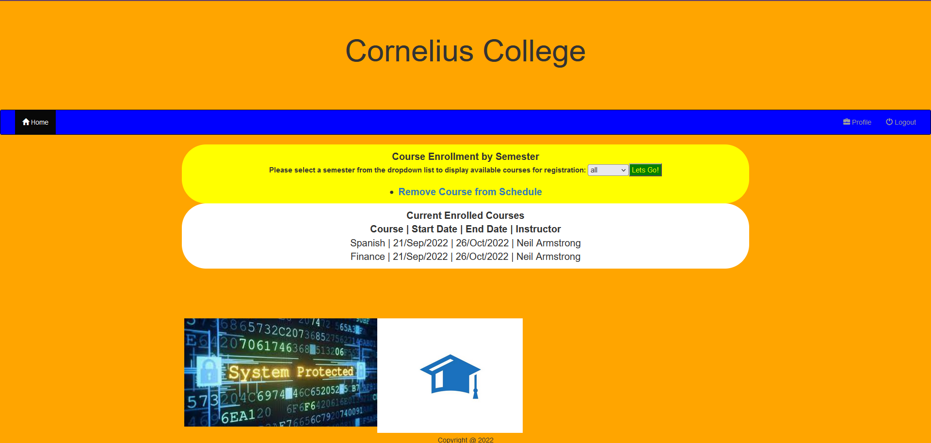
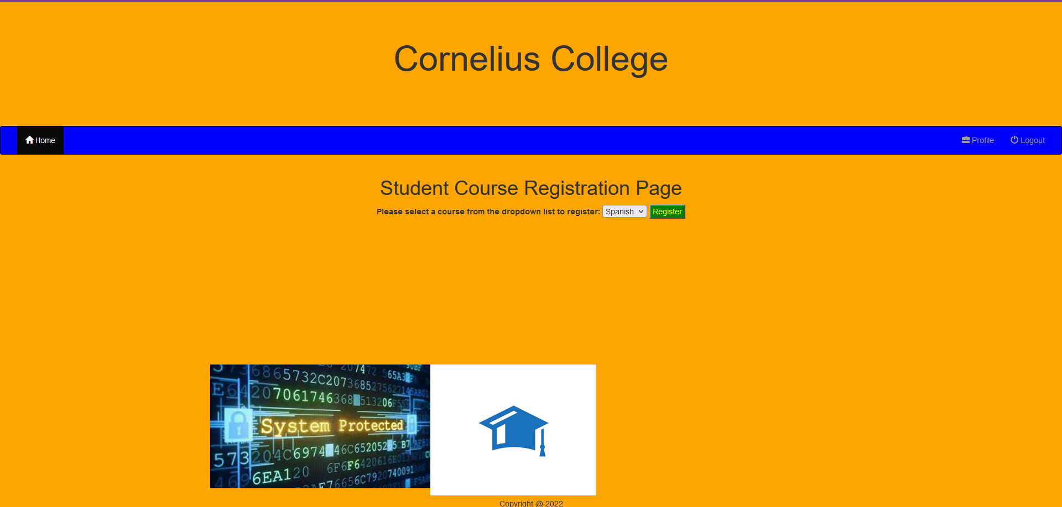
For class registration we have created a dropdown option list in the course landing page, once the following value is selected from the landing page (all, spring, summer, or fall) then the student presses the “Lets Go!” button. The student is then taken to the course registration page, as we mentioned earlier the course registration page receives the session key for selection the student made and an if statement then populates the dropdown list in the course registration page for the courses available for the semester.
Once the course has been selected and the student presses the Register button on the registration page, the value selected is then run against the MySQL server and against the student to verify that
The student is not already assigned to the course
The student does not already have more than 4 courses assigned to him
The course does not have more than the max amount of students
In the event that a course does have more than the max amount of students already assigned, then the student is added to a wait list and the wait list table in the database is updated with the student being assigned to that course.
Additionally, the student will be notified on the course registration page if the student is added to the waitlist for a course.
Course Landing Page
Course Registration Page

Slide 11

PHP code Discussion
According to Connolly & Hoar (2018) the $_SESSION super-global allows you to pass values in arrays between sessions, additionally the session state is stored between user sessions thus a key and value pair set for a session by one user is not the same as when set by another users session, thus if one user is logged in and another has not completed logging in yet the session state can handle the requests from each user separately, and handle things differently by hiding or displaying links in the same location on pages through if statements. Additionally, the session_start function is provided inside of PHP code blocks that are called on the web pages. Thus, as an example when the student or teacher goes to the profile page after successfully logging into the system they are then displayed with their information in a html container. This above behavior additionally happens when displaying the currently assigned courses to signed in students when going to the course landing page.
We have created if statement checks throughout the code in our project to help make sure that if something happens such as too many students in a course, too many courses already assigned to a student, or student is already assigned the course, that the system behaves as expected.

Slide 12
Conclusion
In this above presentation I have summarized the key aspects of the SRS document. Showcased the UML design model that was created for this software project. Explained the design of the landing, login, and enrollment pages that were created. Explained the MySQL database and class registration that were developed. Finally, discussed the PHP code that was written for this software project. Thanks again for taking the time to listen to this presentation!

Slide 13
References
American Public University (n.d.) Problems with Course Registration. American Public University. Retrieved from https://www.apu.apus.edu/help/courses-and-registration/problems-with-course-registration.html
Connolly, R., & Hoar, R. (2018). Fundamentals of web development (2nd ed.). Pearson. Retrieved from https://ashford.instructure.com/courses/103482/modules/items/5252742
Tsui, F., Karam, O., & Bernal, B. (2018). Essentials of software engineering (4th ed.). Jones & Bartlett Learning. Retrieved from https://ashford.instructure.com/courses/106524/modules/items/5408048

